Slide 1
Pangenomic Analysis of Soil Microbes
Dejah Smith | Brewer Fall ‘22

Slide 2
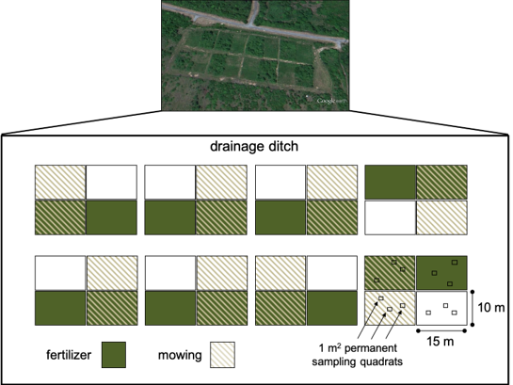
Background + Overview
This project is an extension of an ongoing initiative that is measuring the effects of human activities related to land use on nutrient cycles across a low-nutrient coastal plain wetland
The structure of the experiment involves 8 plots that undergo either a mowed treatment (M) or a mowed fertilized treatment (MF)
Sanger sequencing was conducted on 10 soil bacterial isolate pairs from the different plot treatments

Slide 3
Key Players
Pseudomonas koreensis
Copiotroph - live in environments with high levels of nutrients, thriving off Carbon availability
Classified as “fast growers”
Arthrobacter ramosus
Oligotroph - live in environments with low nutrients
Classified as “slow growers”

Slide 4
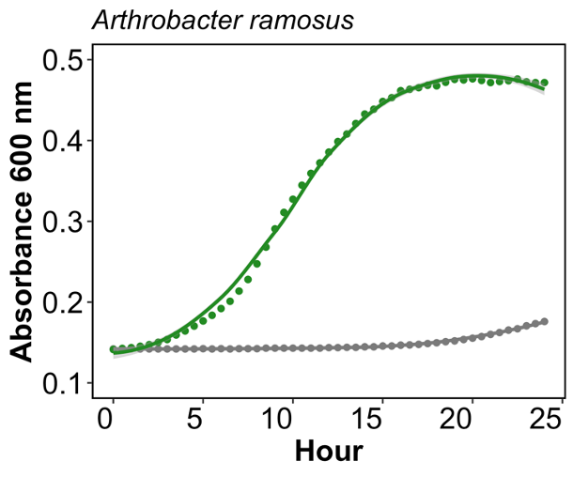
Growth rate of Arthrobacter ramosus
Mowed, unfertilized treatment is grey
Fertilized, mowed treatment is in green
Based on this growth rate, I predicted that the orthologous functional genes present across the two treatments would be low
Image Credit: Aied Garcia

Slide 5
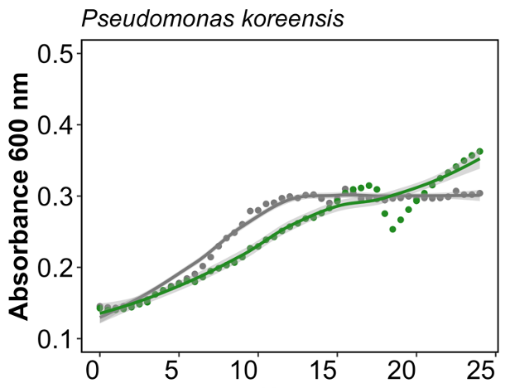
Growth rate of Pseudomonas koreensis
Unfertilized, mowed treatment is grey
Fertilized, mowed treatment is in green
Based on this growth rate, I predicted that there would be a higher number of orthologous functional genes present across the two treatments
Hour
Image Credit: Aied Garcia

Slide 6
Clusters of Orthologous Genes (COGs)
Gene clusters can be present across various genomes and are categorized by their function
The COG20 pathway relates to a set of genes that function to drive processes related to nutrient uptake, metabolism and protein synthesis
As this project is related to effect of human activity on plant-microbe relationships and nutrient accessibility, this pathway was the most fitting to annotate against

Slide 7
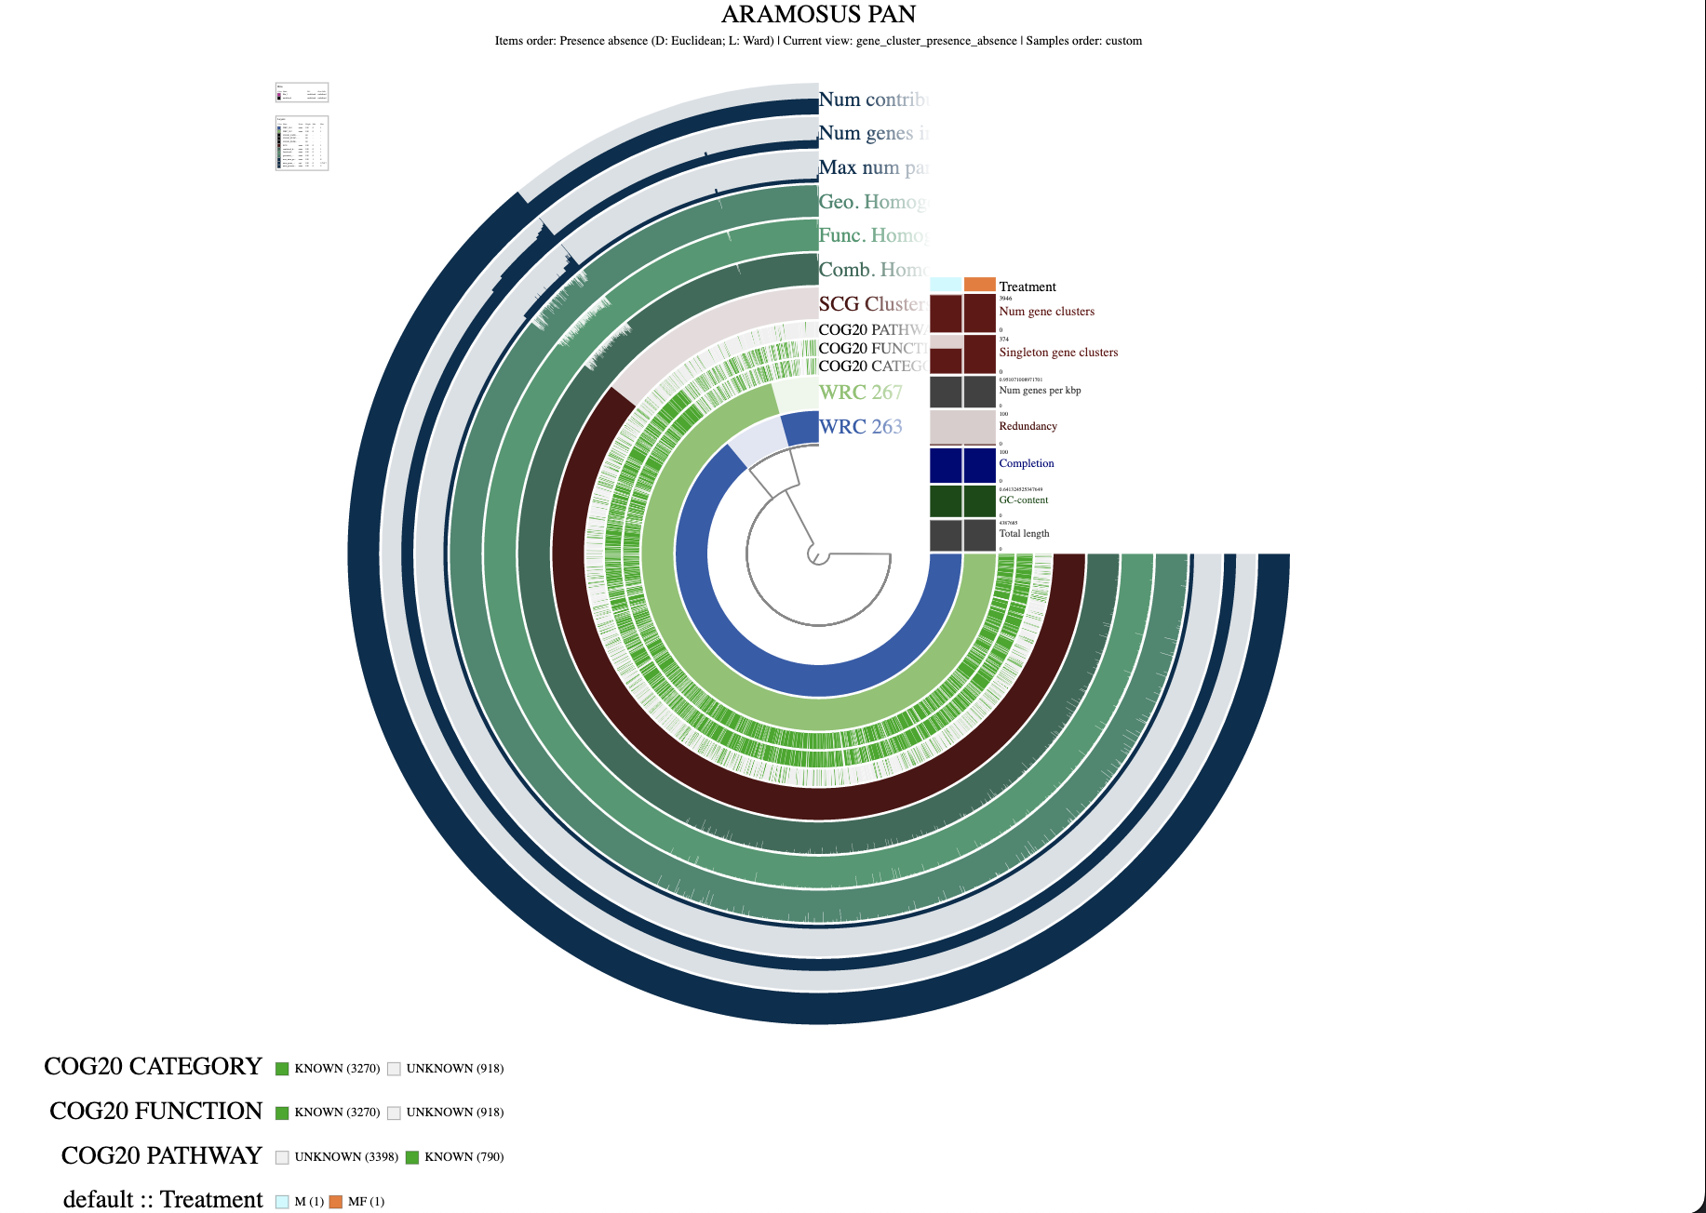
Phylogenetic tree for Arthrobacter ramosus

Slide 8
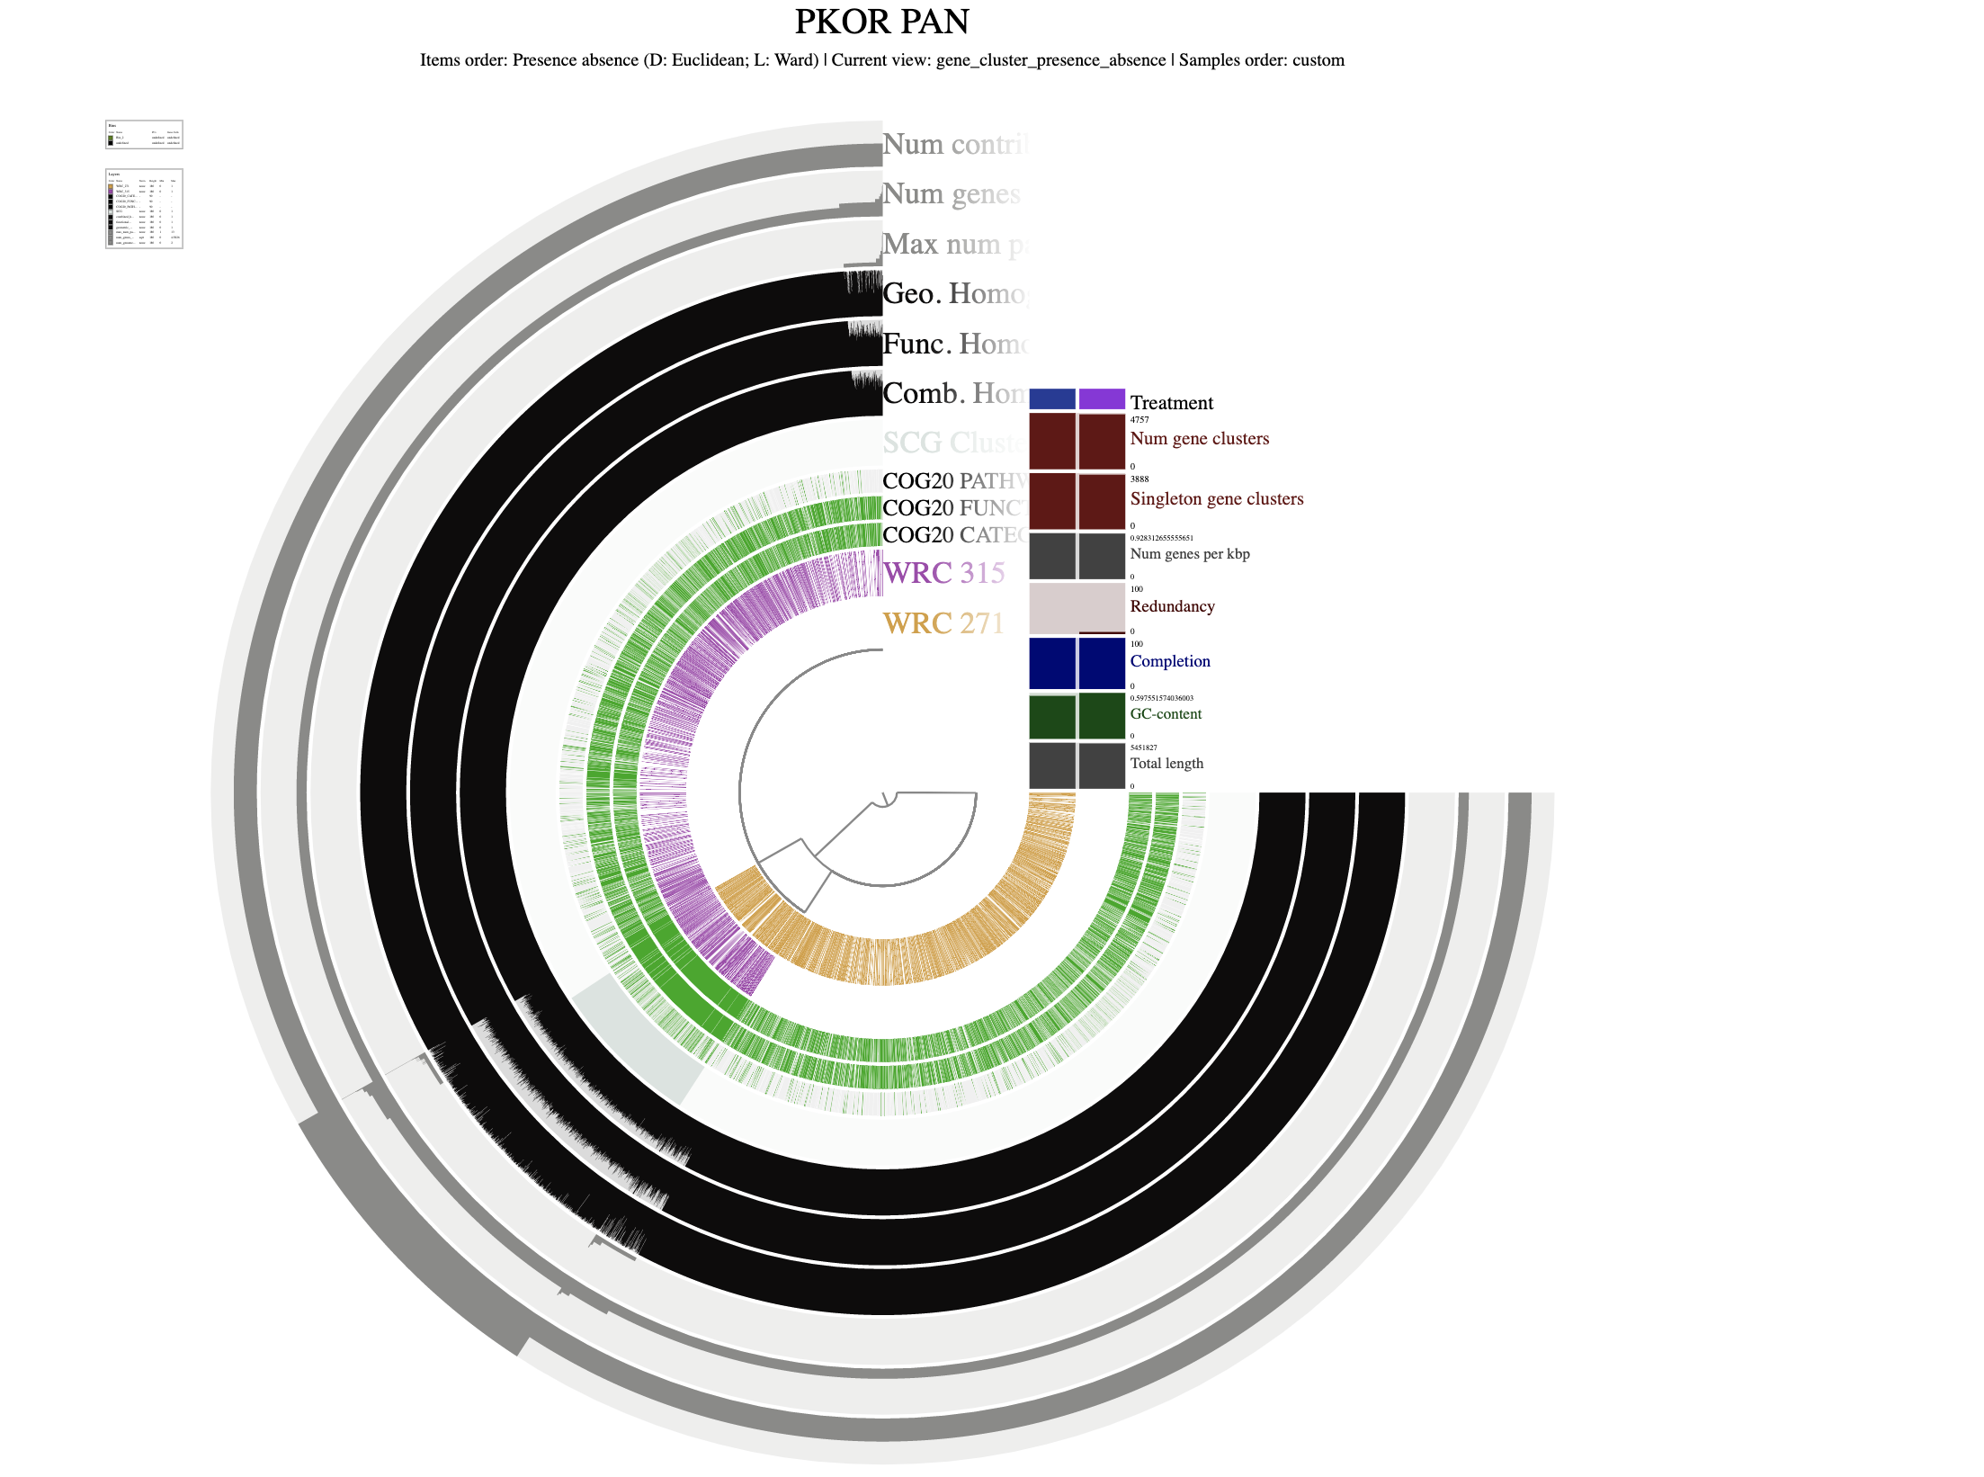
Phylogenetic tree for Pseudomonas koreensis

Slide 9
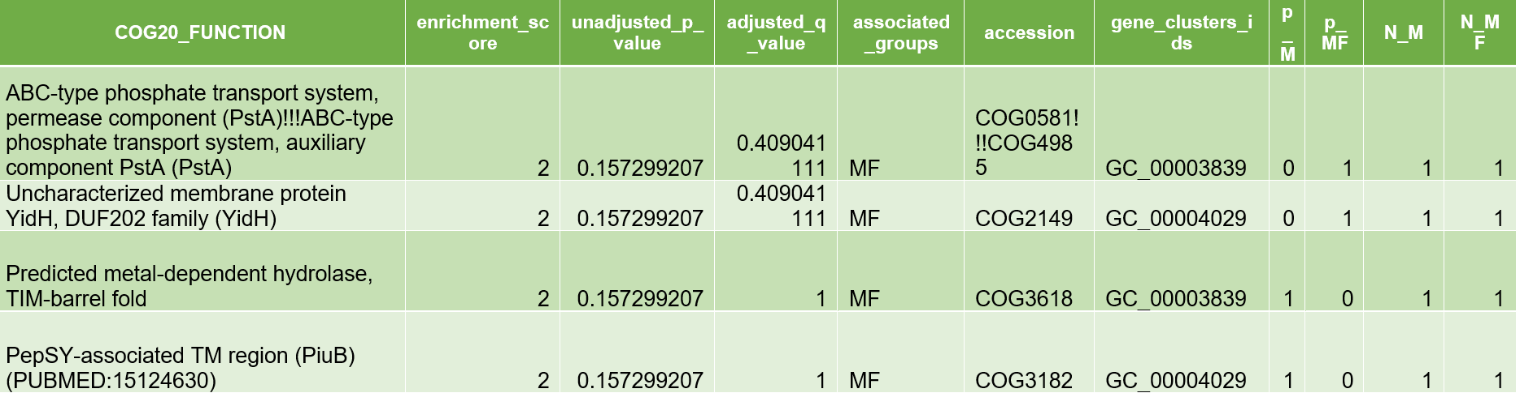
Enriched Functions Crossover
Notes:
OG20_FUNCTION: this is the functional pathway and set of genes that the enrichment was calculated against enrichment_score: this is a measure developed by statistician, Amy Willis to quantify how much the function shown is unique to genomes within a group against your genomes unadjusted_p_value: this is the p-value for the enrichment test adjusted_q_alue: this is the q-value used to control the false discovery rate of multiple tests associated_groups: the groups that are assoociated with the function function_accessionn: accession number gene_clusters_ids: gene clusters associated with the function listed p_M, p_MF: groups based on treatment either mowed (M) or mowed fertilized (MF) N_M, N_MF: the total number of genomes within the group specified

Slide 10
What does this tell us?
The functional genes found within our genomes and across the COG20 functional pathway all are related to nutrient uptake, regulation and protein synthesis.

Slide 11
Gene pstA
Functions to allow transport of inorganic phosphates for the production of ATP and synthesis of proteins.
Notes:
OG20_FUNCTION: this is the functional pathway and set of genes that the enrichment was calculated against enrichment_score: this is a measure developed by statistician, Amy Willis to quantify how much the function shown is unique to genomes within a group against your genomes unadjusted_p_value: this is the p-value for the enrichment test adjusted_q_alue: this is the q-value used to control the false discovery rate of multiple tests associated_groups: the groups that are assoociated with the function function_accessionn: accession number gene_clusters_ids: gene clusters associated with the function listed p_M, p_MF: groups based on treatment either mowed (M) or mowed fertilized (MF) N_M, N_MF: the total number of genomes within the group specified

Slide 12
Gene yidH
Functions to respond to oxidative stress in the membrane
Notes:
OG20_FUNCTION: this is the functional pathway and set of genes that the enrichment was calculated against enrichment_score: this is a measure developed by statistician, Amy Willis to quantify how much the function shown is unique to genomes within a group against your genomes unadjusted_p_value: this is the p-value for the enrichment test adjusted_q_alue: this is the q-value used to control the false discovery rate of multiple tests associated_groups: the groups that are assoociated with the function function_accessionn: accession number gene_clusters_ids: gene clusters associated with the function listed p_M, p_MF: groups based on treatment either mowed (M) or mowed fertilized (MF) N_M, N_MF: the total number of genomes within the group specified

Slide 13
Metal-dependent hydrolase (general)
Functions to break down nutrients into smaller units
Notes:
OG20_FUNCTION: this is the functional pathway and set of genes that the enrichment was calculated against enrichment_score: this is a measure developed by statistician, Amy Willis to quantify how much the function shown is unique to genomes within a group against your genomes unadjusted_p_value: this is the p-value for the enrichment test adjusted_q_alue: this is the q-value used to control the false discovery rate of multiple tests associated_groups: the groups that are assoociated with the function function_accessionn: accession number gene_clusters_ids: gene clusters associated with the function listed p_M, p_MF: groups based on treatment either mowed (M) or mowed fertilized (MF) N_M, N_MF: the total number of genomes within the group specified

Slide 14
Gene PiuB or PepSY
Functions to regulate peptidase activity, specifically those that inhibit chaperones. This gene also plays a role in protecting the cell from lysis.
Notes:
OG20_FUNCTION: this is the functional pathway and set of genes that the enrichment was calculated against enrichment_score: this is a measure developed by statistician, Amy Willis to quantify how much the function shown is unique to genomes within a group against your genomes unadjusted_p_value: this is the p-value for the enrichment test adjusted_q_alue: this is the q-value used to control the false discovery rate of multiple tests associated_groups: the groups that are assoociated with the function function_accessionn: accession number gene_clusters_ids: gene clusters associated with the function listed p_M, p_MF: groups based on treatment either mowed (M) or mowed fertilized (MF) N_M, N_MF: the total number of genomes within the group specified

Slide 15
Future Work
Why are the only orthologous genes seen in the mowed fertilized treatment?
Where are these genes located within the genome and what can this location tell us?
How do we mitigate environmental stress to preserve these plant-microbe relationships to maintain biodiversity in these areas?

Slide 16
References + GitHub
Anvi'o - https://anvio.org/ , https://anvio.org/learn/pangenomics/
NCBI COG Database - https://www.ncbi.nlm.nih.gov/research/cog/
Peralta Lab (growth rate graphs + additional images)
https://github.com/dejsmith7/Final-Project-Brewer_DS

